Slide 1
Placemaking Update
Columbia Foundation
January 23, 2019

Slide 2
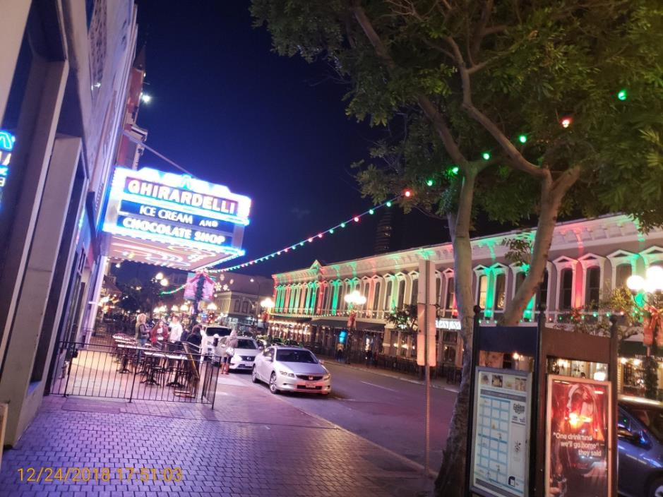
Placemaking Update
Pole-to-Pole Lighting
Flexible strand of high-intensity RGB Color Changing LED nodes
Pole to Pole.
10 Year Material and Labor Warranty
Locations
India Street (Ash to Broadway)
Columbia Street (Ash to Broadway)
Budget - $147,538 (Columbia & PBID)
Timeline – May/June 2019
5th Avenue (Gaslamp)

Slide 3
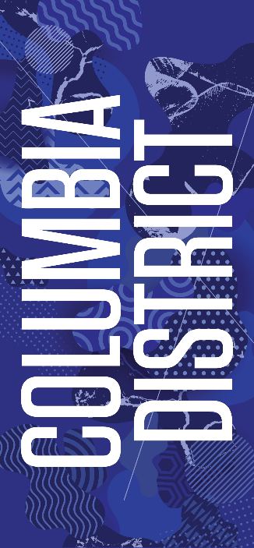
Placemaking Update
Streetpole Banners
18”x36” vinyl banner
Two banners per pole
Locations
India Street (Ash to Broadway) – 18 locations
Columbia Street (Ash to Broadway) – 16 locations
Kettner Boulevard (Ash to Broadway) – 11 locations
A Street (Kettner to Union – 11 locations
Budget - $13,800 (PBID)
Timeline – 1 month upon design approval
Option A – Coincide with install of lights and planters
Option B – Install prior to lights and planters

Slide 4
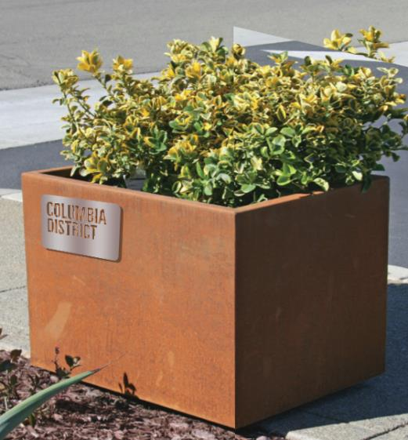
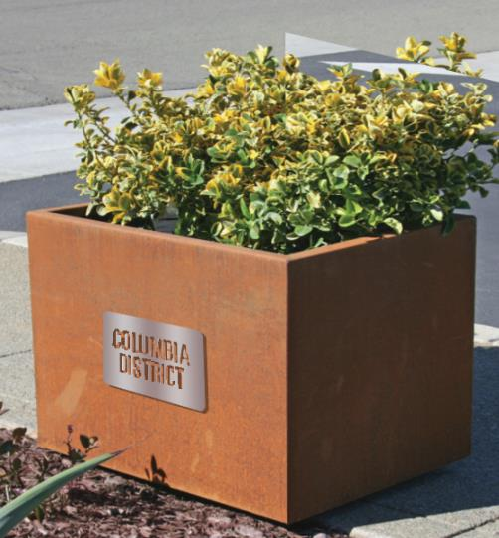
Placemaking Update
Corner Planters
36”L x 30”W x 30”H weathered steel planter (16 total)
Columbia Branded Cut Out Stainless Steel Plate
Drought tolerant landscaping
3 Year Warranty
Locations
Two planters located at intersections along:
India Street (Ash to Broadway)
Columbia Street (Ash to Broadway)
Budget - $35k (Columbia Foundation)
Timeline – May/June 2019
Option B
Option A

Slide 5
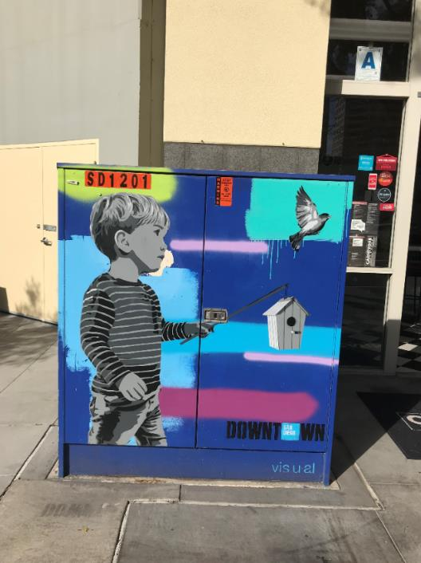
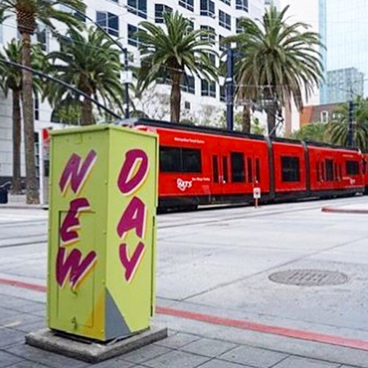
Placemaking Update
Utility Box Art
20 utility boxes painted in Columbia District

Slide 6
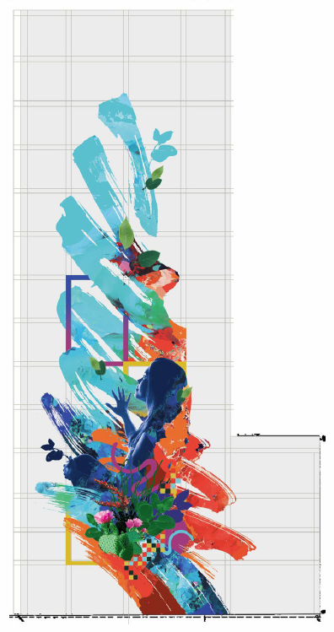
Placemaking Update
2 Columbia Place Mural
Location
2 Columbia Place (1230 Columbia St)
North facing wall
Artist - David Hook
Timeframe - TBD
Concept

Slide 7
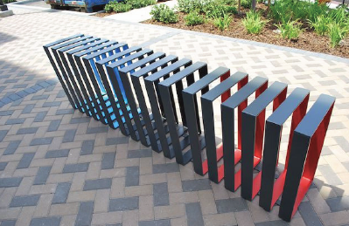
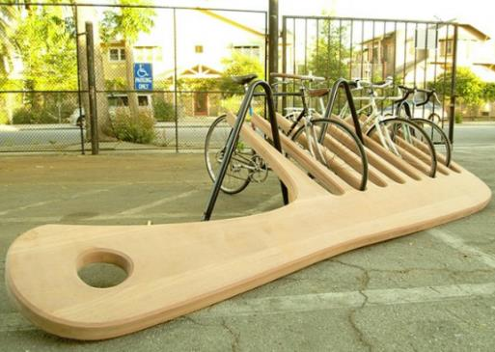
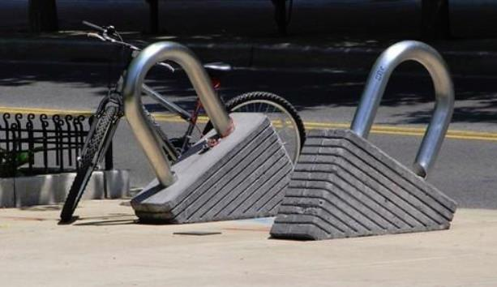
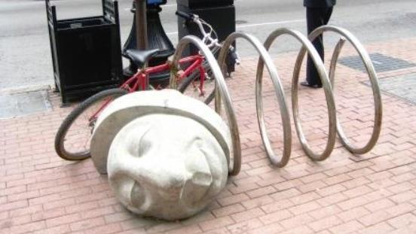
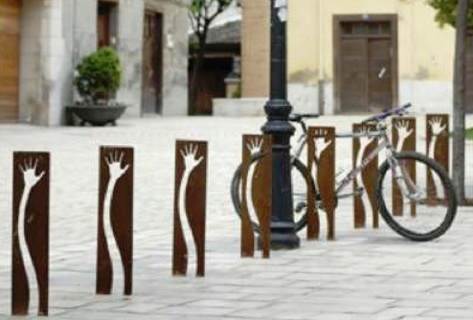
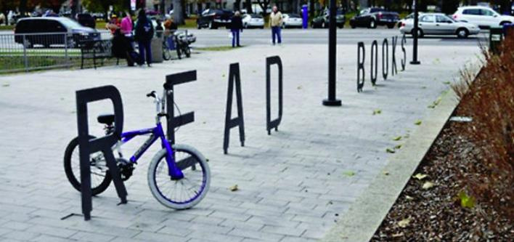
Placemaking Update
Creative Bike Racks

Slide 8
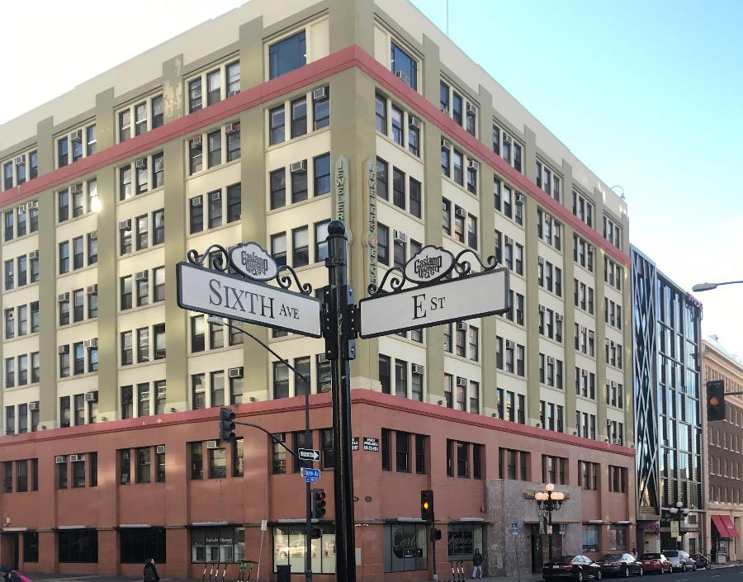
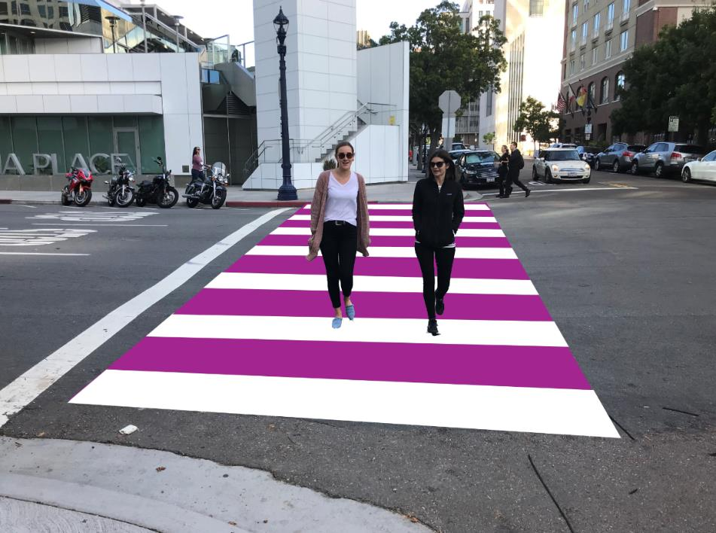
Placemaking Update
FY2020 Priorities

Slide 9
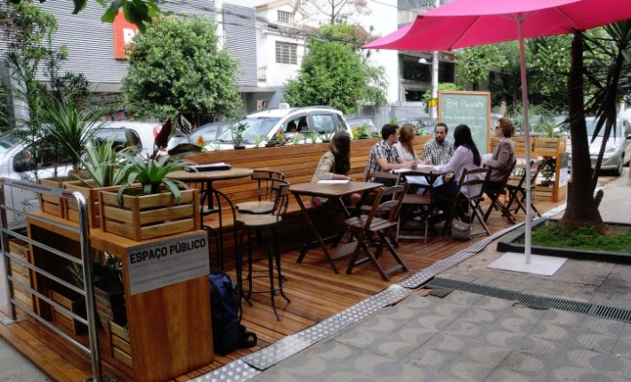
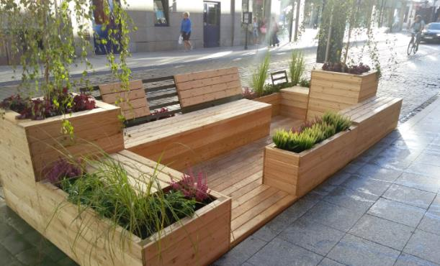
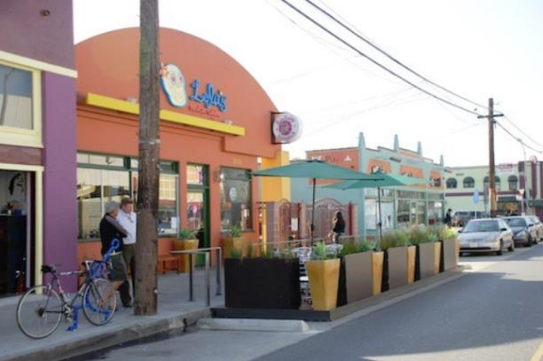
Placemaking Update
FY2020 Priorities

